Slide 1
The College Board
Show Colleges You’re Ready
Annual Report for SAT results 2018

Slide 2

How did we fare this year?
How to make next year better?

Slide 3
By the end of today…
you will know
How did we fare in 2018?
How did ACT do in 2018?
How to improve on our participation next year?

Slide 4
Methodology
Using state-of-art Jupyter notebook and the ever popular Python, the team has worked on a dataset that comprises of data from SAT 2017/2018 and ACT 2017/2018 averages of participation rates, test scores from each component of the tests across all 51 states in the US
SAT 2017 Scores: https://blog.collegevine.com/here-are-the-average-sat-scores-by-state/
SAT 2018 Scores: https://blog.prepscholar.com/average-sat-scores-by-state-most-recent
ACT 2017 Scores: https://blog.prepscholar.com/act-scores-by-state-averages-highs-and-lows
ACT 2018 Scores: https://magoosh.com/hs/act/2016/average-act-score-by-state/

Slide 5
How did we fare in 2018?

Slide 6
How did ACT do in 2018?

Slide 7
How did we fare in 2018?

Slide 8
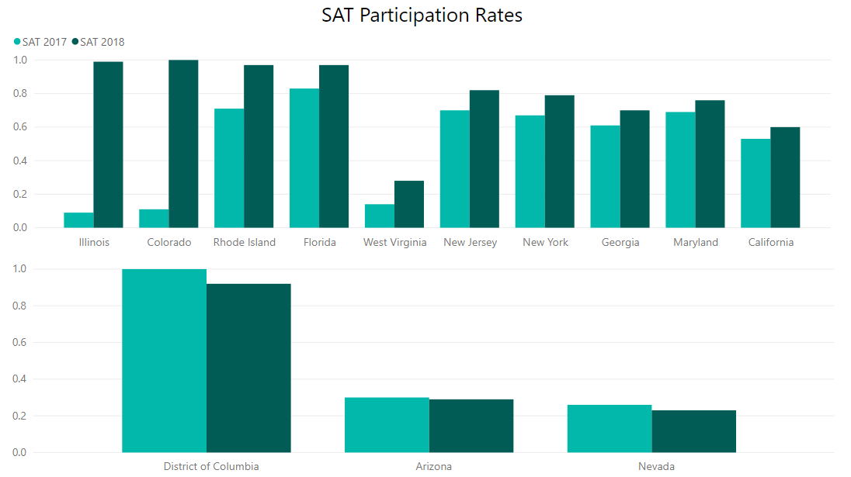
Top 10 states changes in SAT participation 17 vs 18
How did we fare in 2018?
National Average: 40% to 47%
+14%
Best performing states
+26%
+12%
+12%
+7%
+9%
+7%
+90%
+89%
+14%
-8%
Least performing states
-1%
-3%

Slide 9
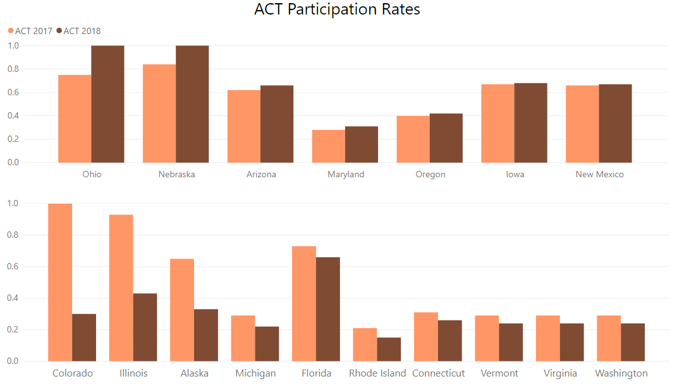
How did we fare in 2018?
Top 10 states changes in ACT participation 17 vs 18
National Average: 65% to 62%
+16%
Best performing states
+25%
+4%
+1%
+1%
+2%
+3%
-7%
Least performing states
-89%
-84%
-32%
-7%
-5%
-5%
-5%
-5%
-6%

Slide 10
Average Scores
How did we fare in 2018?
SAT Total 17 vs 18
ACT Composite 17 vs 18
21.5
21.5
1126
1125
ACT English 17 vs 18
SAT English 17 vs 18
20.9
21.0
ACT Maths 17 vs 18
569
567
21.2
21.1
ACT Reading 17 vs 18
SAT Maths 17 vs 18
22.0
22.0
557
557
ACT Science 17 vs 18
21.5
21.3

Slide 11

Moving forward…
Key considerations:
State laws
Current participation rates
Budget

Slide 12
State Laws
Moving forward…
Some states will require students to take either ACT or SAT as part of their high school test
10 states that require the SAT:
Colorado
Connecticut
Delaware
District of Columbia
Illinois
Maine
Michigan
New Hampshire
Rhode Island
West Virginia
11 states that require the ACT:
Alabama
Hawaii
Kentucky
Mississippi
Montana
Nebraska
Nevada
North Carolina
Utah
Wisconsin
Wyoming
Case study: College Board has won a 3yr, $14.3m bid
to give its exam to all public high school juniors in Illinois

Slide 13
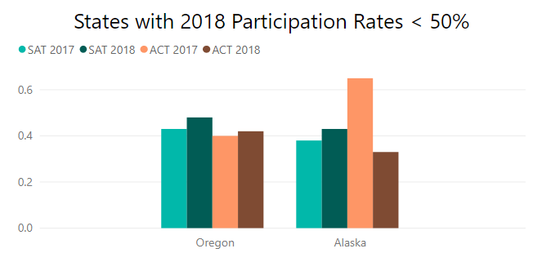
Current participation rates
Moving forward…
To maximise efficiency and stretch out dollars spent, we have applied the current filters to the participation rates:
1. Remove states that has compulsory papers
2. Remove states that has more than 50% participation rates in 2018 for both papers
SAT: +5%,
43% to 48%
ACT: +2%,
40% to 42%
SAT: +5%,
38% to 43%
ACT: -32%,
65% to 33%,

Slide 14
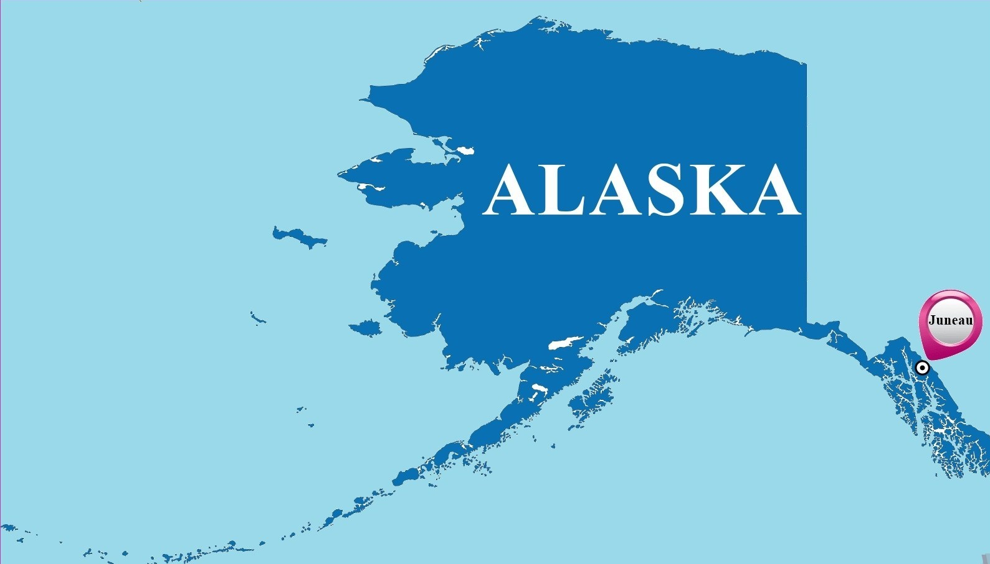
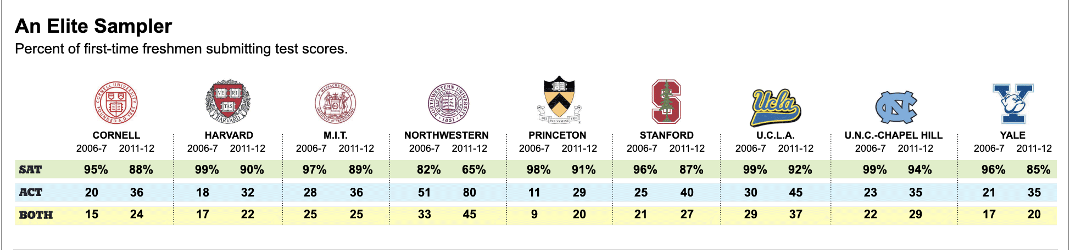
How?
Moving forward…
Recommendations:
Alaska has high school test called PEAKS but there isn’t any exit exam, the College Board will then be able to enter and promote the test by[1] :
a) Elite school students usually take SAT [2]
b) SAT is arguably better than ACT [3]
c) SAT's growing presence in the West coast makes SAT more relevant
Source:
[1]https://www.edweek.org/ew/section/multimedia/states-require-students-take-sat-or-act.html
[2]https://archive.nytimes.com/www.nytimes.com/interactive/2013/08/04/education/edlife/where-the-sat-and-act-dominate.html
[3]https://www.studyusa.com/en/a/1305/act-vs-sat-ultimate-guide-to-choosing-the-right-test

Slide 15

Until the next project….

